Slide 1
Tool Resource Prediction for Genomic
Datasets
Masterproject: Öner Aydogan

Slide 2
Motivation
Galaxy: web-based, open-source scientific analysis platform
Over 5500 tools for bioinformatics applications
fixed amount of memory for each tool
Overallocation → waste of resources
Underallocation → failure of tools

Slide 3
Motivation
Example with RNA-Star:
Uses in one job 30 GB, in a different job 10 GB
Suppose 20 GB are allocated
Insufficient memory or too much would be assigned
→ Usage of machine learning methods to predict memory usage
Automatically learn patterns and decision rules from data

Slide 4
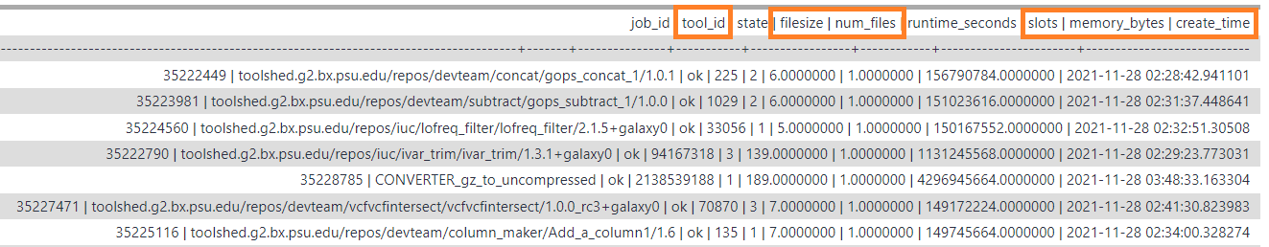
Galaxy job run dataset & Preprocessing
Collected from 31.12.2019 to 23.05.2022 on Galaxy Europe
38 millions entries (10 GB) → after preproccessing 26 million (2.8 GB)
Filter invalid combinations for Filesize & Number of files

Slide 5
Machine Learning methods
Random Forest - XGB (Extreme Gradient Boosting)
Linear Regression - SVR (Support Vector Regression)
Baseline:
LR & SVR: using default parameters
RF & XGB: n_estimators = 200

Slide 6

Training & evaluation
Input features: Filesize, Number of files & Slots
Target: Memory bytes
Example:
fastqc/0.72 → train & test set (80%|20%) → 5-fold CV → evaluation on test set
scoring method: $R^{2}=1−\frac{\sum{{ \left(y_{i} − \hat{ y}\right)}^{2}}}{\sum{ {\left(y_{i} − \overline{y}\right)}^{2}}}$

Slide 7

Removing faulty data
Initial assigned memory:
Given by tool destinations file
Default value of 1 GB
$\max{_memory}=initial_assigned_memory ∗2^{3}=initial_assgined_memory ∗8$
Filter entries exceeding max_memory or 1 TB
Validity of the dataset is put in question

Slide 8
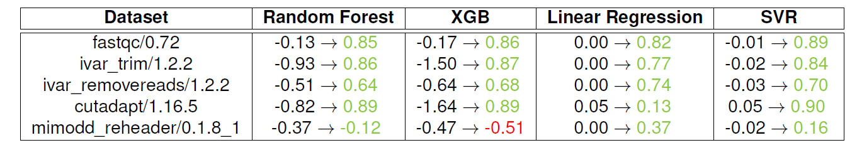
Results: Removing faulty data

Slide 9
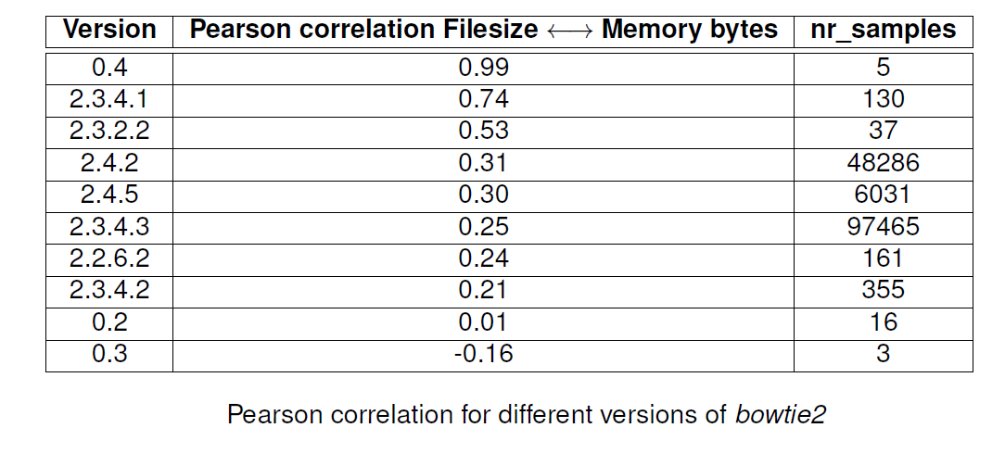
Correlation analysis
Pearson correlation coefficient: Filesize ↔ Memory bytes
about 300 of total 4800 tools moderate to strong negative correlation

Slide 10
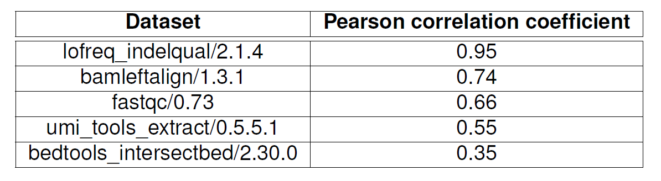
Moderate-high correlation

Slide 11
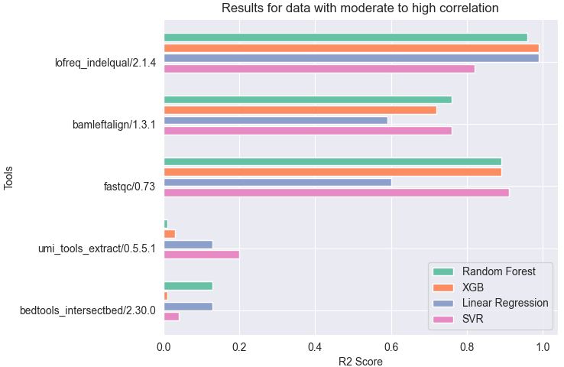
Results: Moderate-high correlation
For datasets with very high correlation → all models perform well
Lower correlation → performance decreases

Slide 12
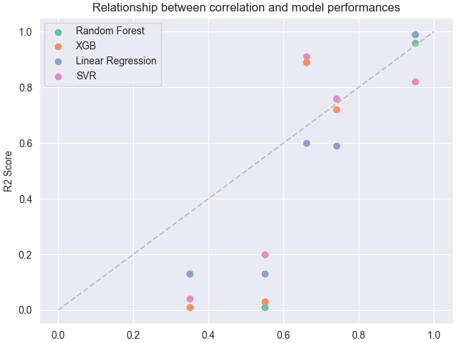
Results: Moderate-high correlation
Clear tendency:
the greater the correlation, the better all models perform

Slide 13
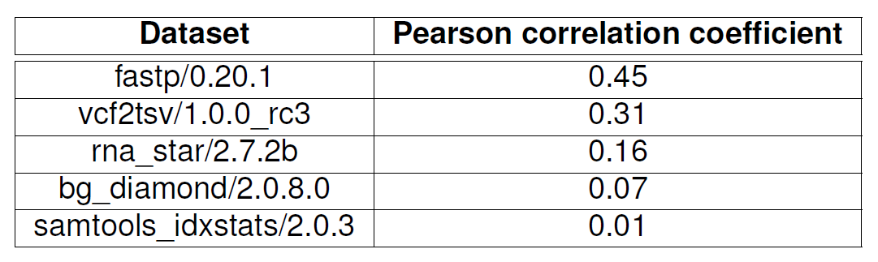
Low-moderate correlation:

Slide 14
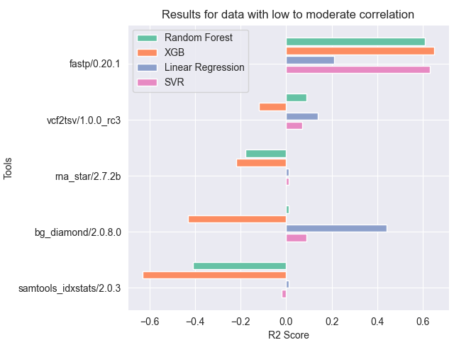
Results: Low-moderate correlation:
For datasets with low correlation →R2 score varies greatly for all models
General performance not good
XGB performs especially bad → hyperparameters need to be optimized

Slide 15
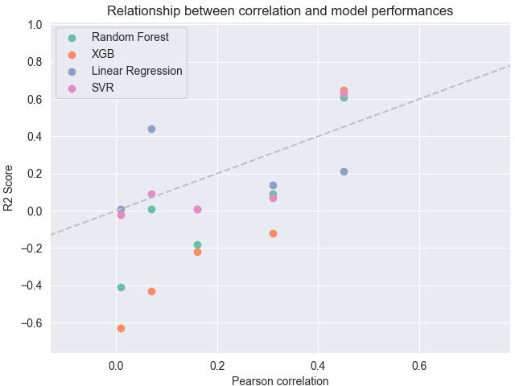
Results: Low-moderate correlation:
For increasing correlation → clear upward trend in performance
Performance for bg_diamond/2.0.8.0 stands out

Slide 16
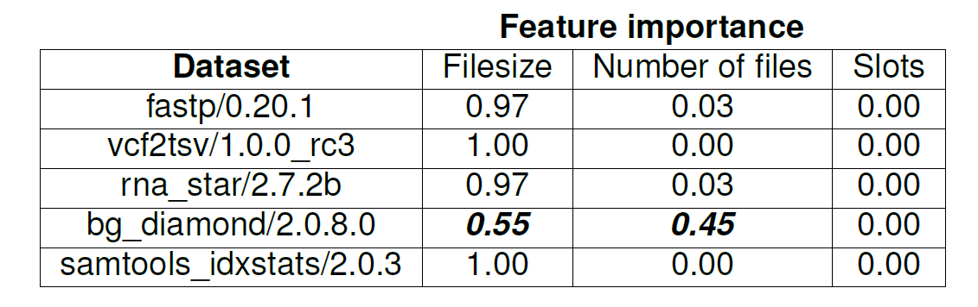
Results: Low-moderate correlation:
Models rely mostly on Filesize feature
Low correlation → models perform bad
Slot is redundant most of the time
Problematic because 50% of the tools show correlation < 0.5

Slide 17
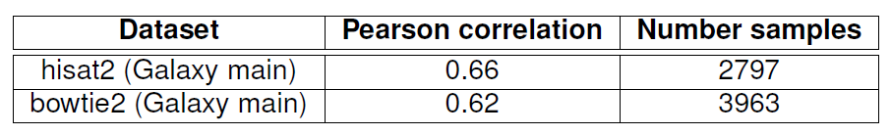
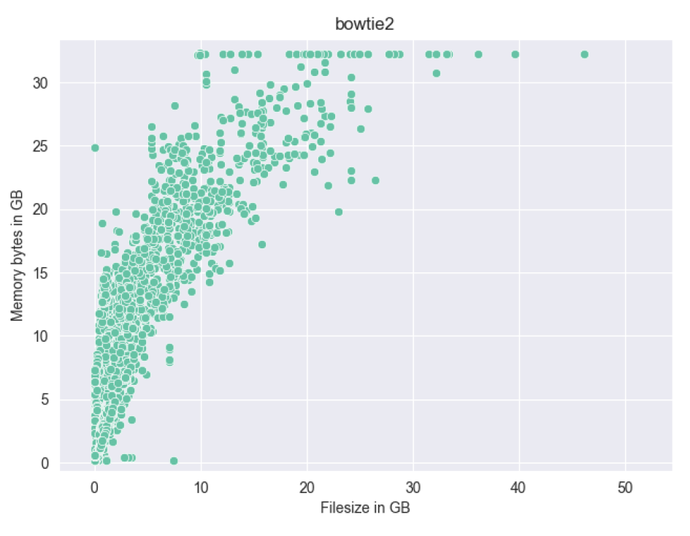
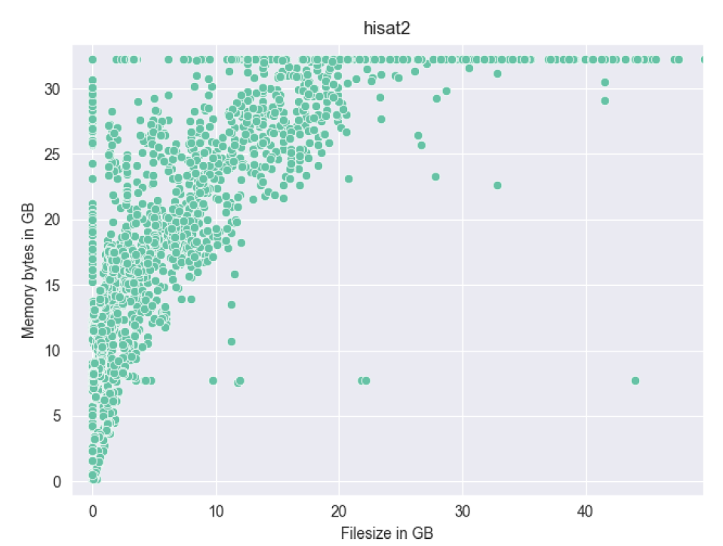
Performance on other datasets

Slide 18
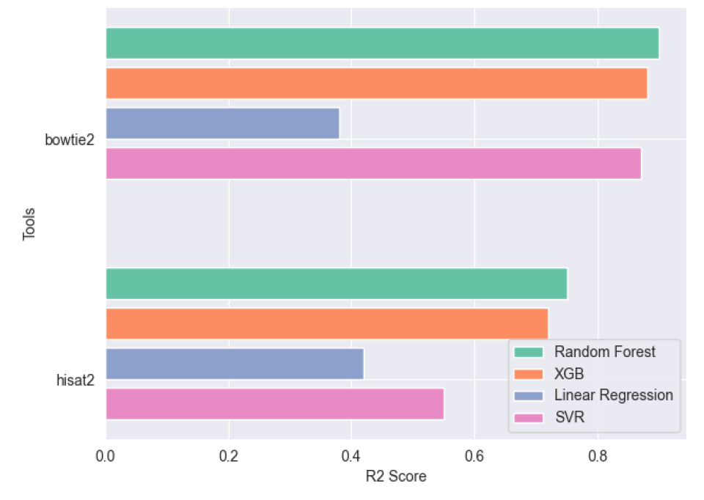
Results: Performance on other datasets
Linear Regressor performed worst
Models performed worse for hisat2 than for bowtie2
Possible reasons:
Fewer samples (-30%)
Data points with great variance

Slide 19
Hyperparameter Optimization
Comparison to Galaxy’s current method of memory assignment
Models need to be optimized → HalvingGridSearchCV
Random Forest | XGB | SVR
n_estimators = [50, 100, 200, 500] | learning_rate = 8 samples from log_space [0.003 to 0.3] | kernel = ["rbf", "sigmoid", "poly"]
max_depth = [None, 4, 16, 32] | n_estimators = [50, 100, 200, 500] | C = [0.01, 0.1, 0.5, 1, 2, 4]
min_samples_split = [2, 4, 8] | max_depth = [2, 6, 16, 32, 64] | gamma = ["scale", 0.001, 0.01, 0.1, 1]
min_samples_leaf = [2, 4, 8]

Slide 20
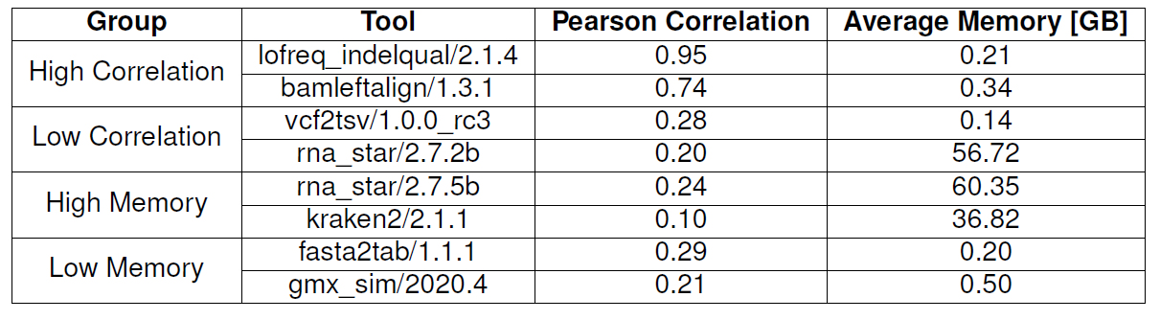
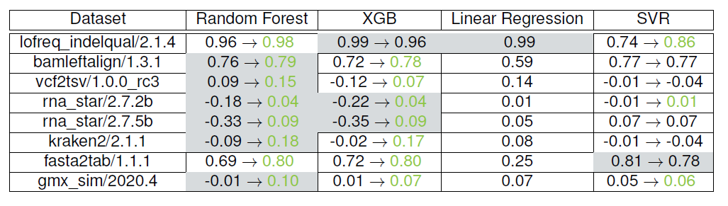
Results: Hyperparameter Optimization

Slide 21
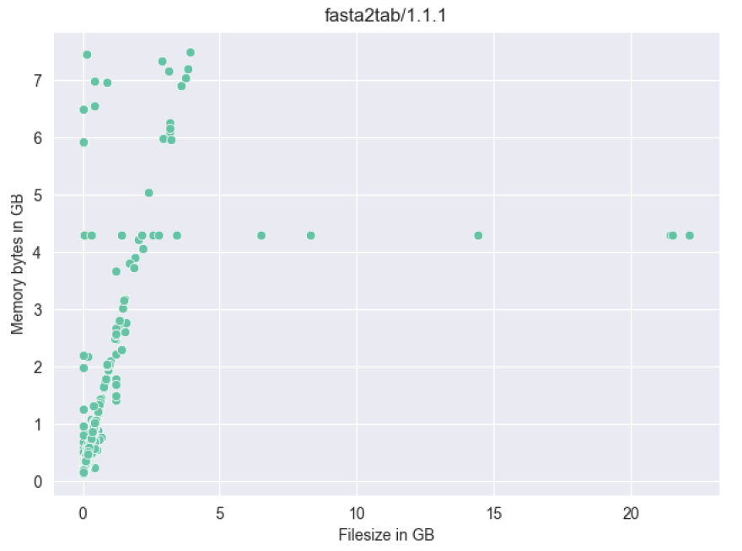
Results: Hyperparameter Optimization
Beside a few outliers → clear pattern visible

Slide 22
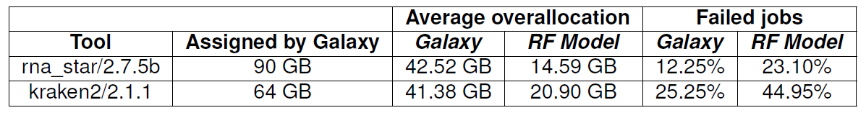
Analysis on resource consumption
Using the best model: how much memory can be saved?
Decrease of 65%/50% memory overallocation for rna_star/kraken2
Increase in percentage of failed jobs

Slide 23
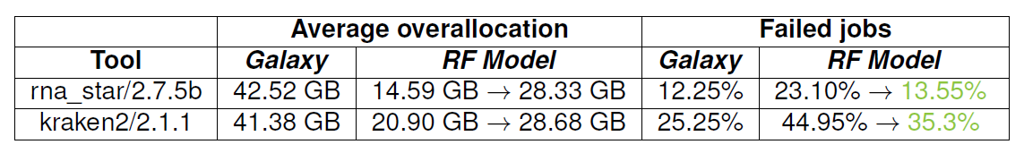
Accuracy-Failure trade-off
Idea: give algorithms success probability of a job
Prediction interval: prediction is expected to be with particular probability
Take maximum of interval as prediction
In theory: job is less likely to fail

Slide 24
Discussion and Conclusion
Existence of invalid entries and other characteristics
Validity of dataset?
All models benefit from filtering faulty data
For strong correlation → accurate and robust prediction
Models rely mostly on one Filesize → too few features
Overallocation of memory reduced by 50% to 65%

Slide 25
Sources

